Slide 1
Model Description (Model developed by Nathan in previous quarter)
Pretrained AlexNet
Dataset: ImageNet (1.2M images in 1K classes) — not histopathology
We train only very last layer (ChatGPT code interpretation)
Frozen layers: 5 convolutional, 3 max-pool, 2 dropout, and first two dense (ChatGPT code interpretation)
Train only final dense layer (8196 trainable params) -> Trains in < 5 mins on T4 GPU(ChatGPT code interpretation)
Trained only on existing patches that Krish identified as high-quality
true_train = [1,2,3,9,53,55,78,85,89]
53 only has 4 images
true_test = [12,60,77,79,90,92 ]
Notes:
train_cases = [2,1,22,9,34,38,53,55,78,62,85,89,21,3,45,49]
test_cases = [77,60,79,70,90,92,25,12]

Slide 2
Which image sizes should be included?

Slide 3
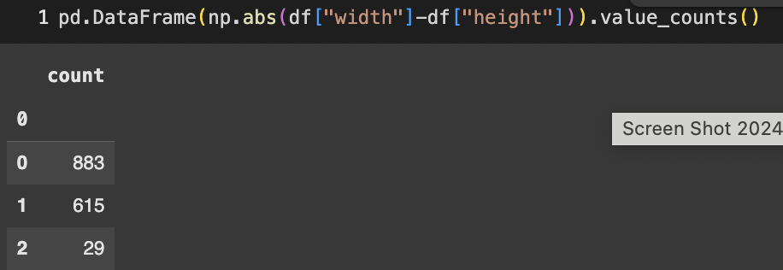
Using width (# pixels) as proxy for image size (colab)
Most images have width = height
When width != height, width very close to height (+/- 1 or +/- 2 pixels)
Mean image size is 148 pixels

Slide 4
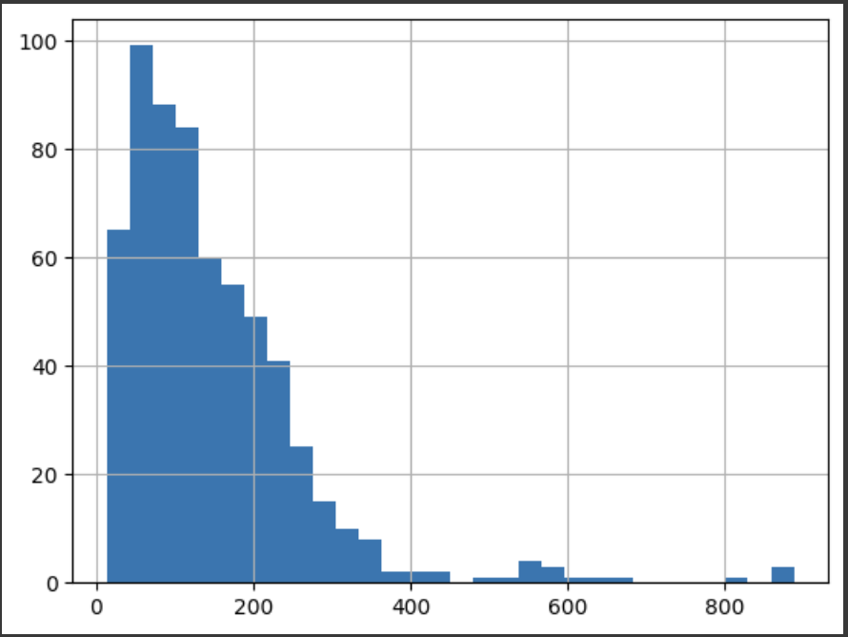
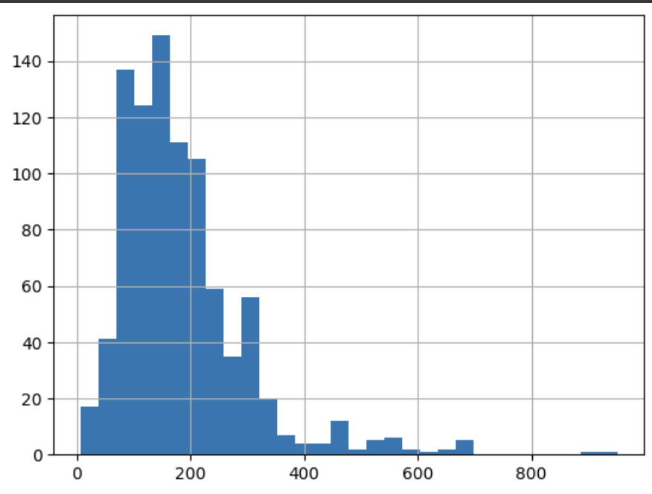
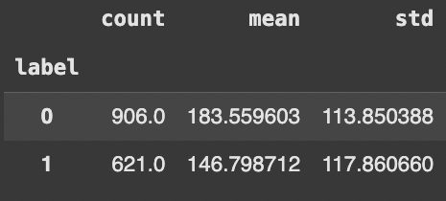
Critical Finding (colab)
Patches for true label = 0 are significantly larger than patches for true label = 1
But sample size is small (trend may change with larger sample size)
Class = 1
Class = 0

Slide 5
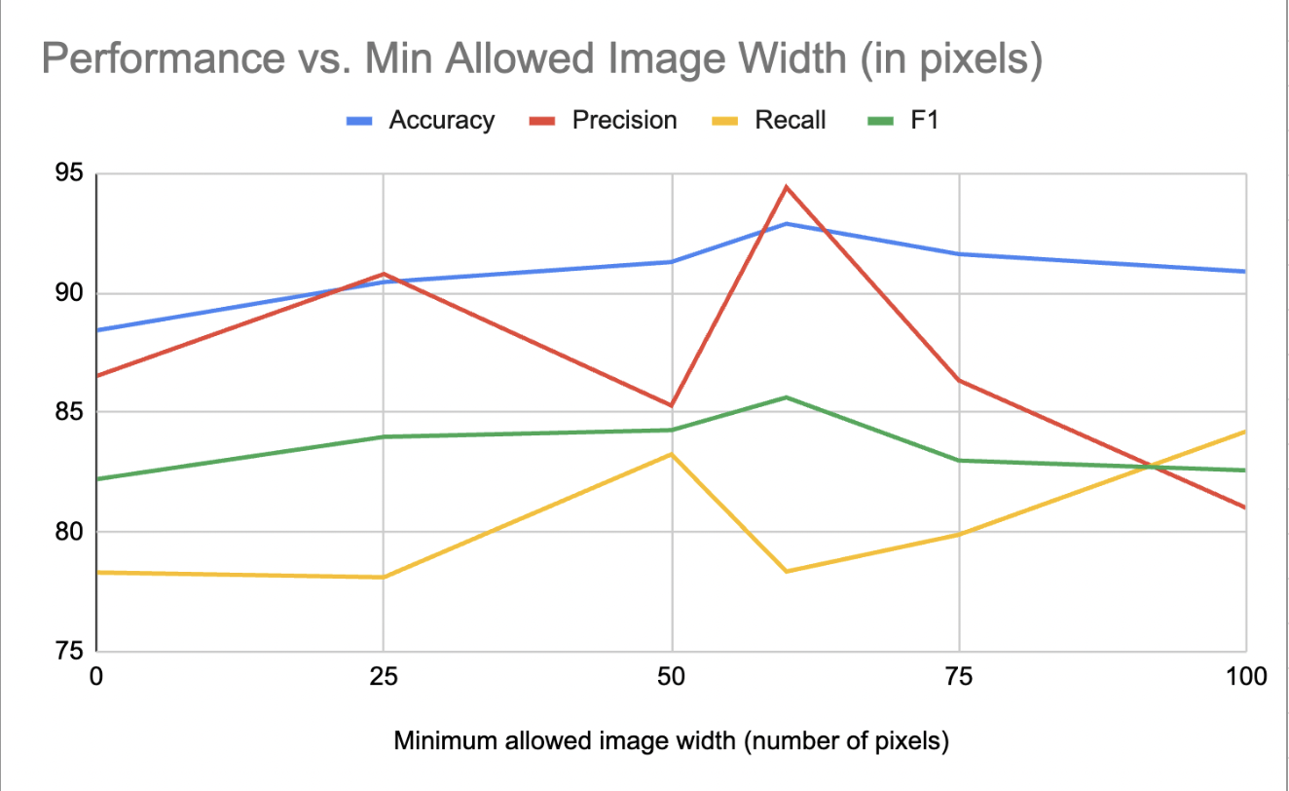
Which images are too small? (colab)
- Model was trained/evaluated only on images with a width > minimum allowed width
- 60 pixel minimum width is best threshold

Slide 6
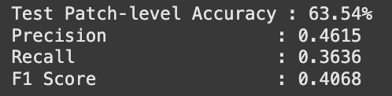
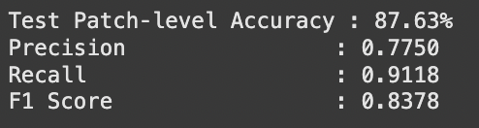
Class imbalance or Bad Images? (colab)
Smallest 10% of images (63-33 class imbalance)
10th to 20th percentile of images (63-34 class imbalance)
Class imbalance matters, but the smallest images are simply too small

Slide 7
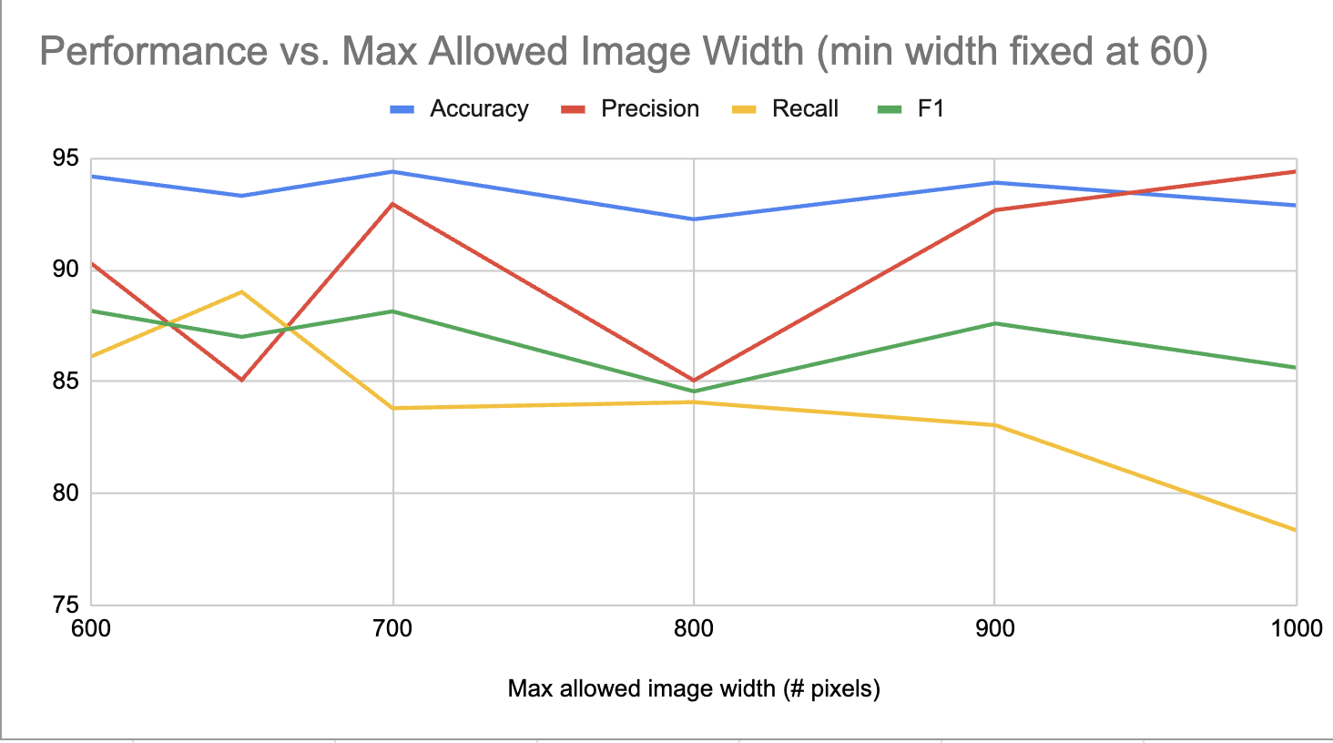
2) With fixed lower bound, what should upper bound be? (colab)
- Set image size lower bound = 60 pixels and adjusted upper size bound
- Poor performance in large samples could be due to extreme class imbalance or bad patches

Slide 8
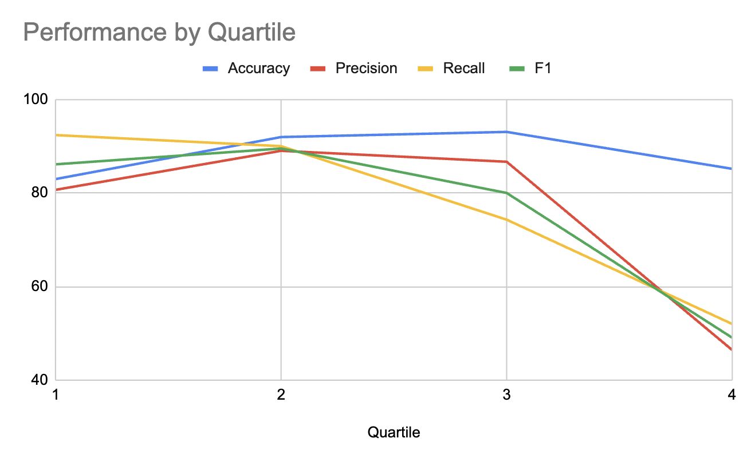
Performance By Quartile (colab)
- Q4 worst due to bad class imbalance (157 benign vs. 25 high-grade) or due to worse patches?

Slide 9
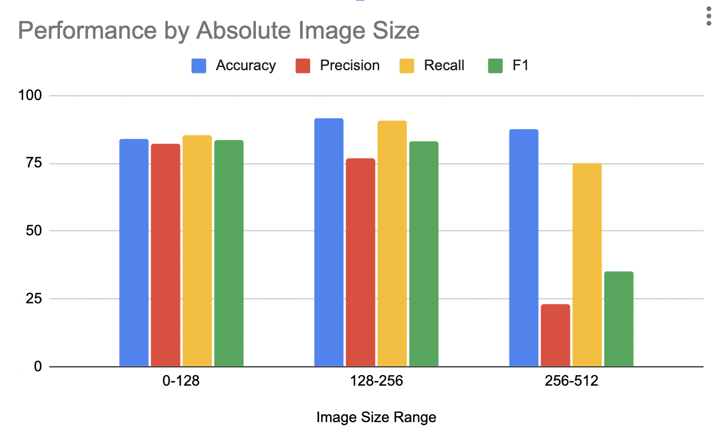
Performance by Absolute Image Size (colab)
Extremely severe class imbalance for large images

Slide 10
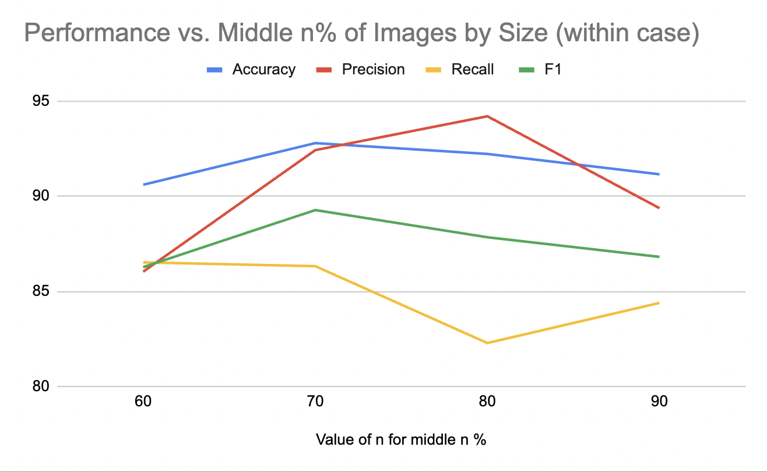
Performance vs. Middle n% of Images (colab)
- if n = 60, then we only use images in 20th to 80th percentile within case
- 30% of data lost — is that ok?

Slide 11
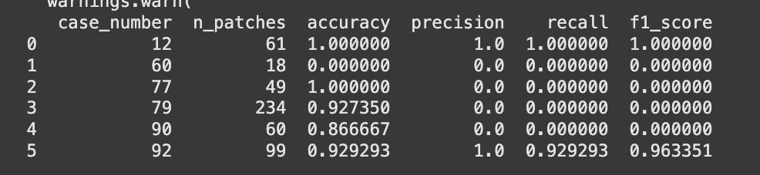
Caveats (colab)
Small sample size of ideal images that are already patched
Very poor performance for some cases
Not a single correct prediction for case 60

